Slide 1
Music origin classification
Group 18: Sili Wei

Slide 2
Description
n=1059
p=116
n+ = 932
n- = 127
imbalance ratio: 13.63%
features: audio features of the track
response: music from northern /southern hemisphere

Slide 3
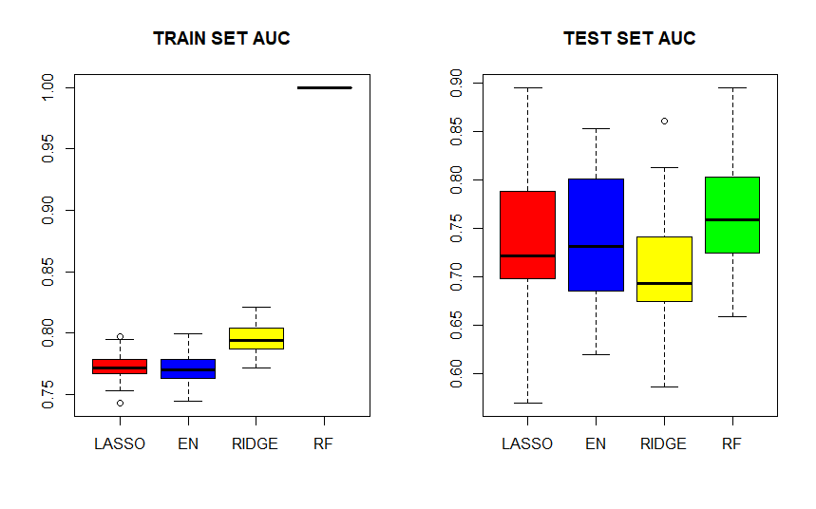
Boxplot of 50 AUCs

Slide 4
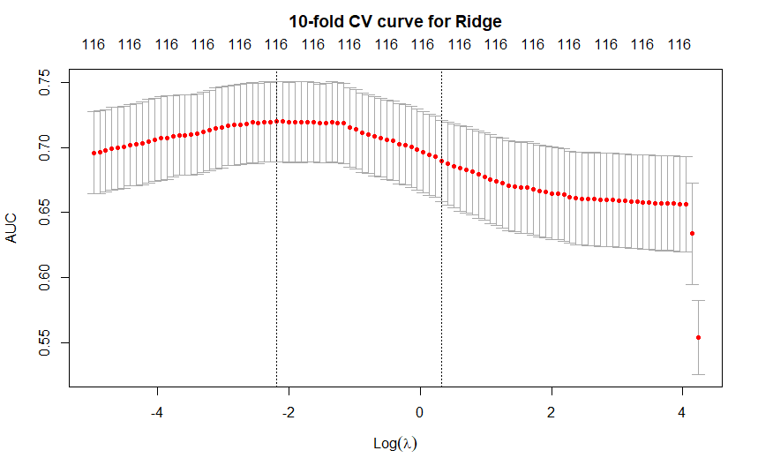
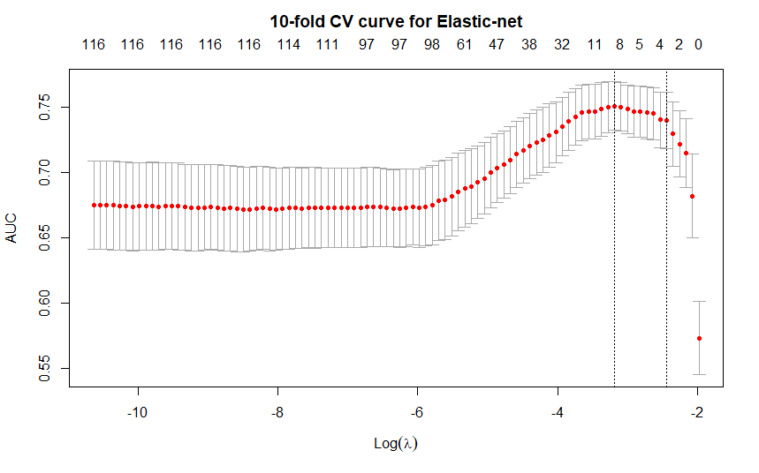
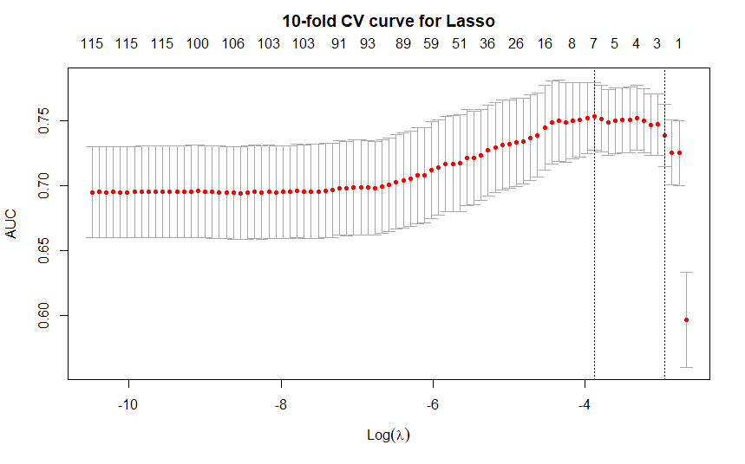
10-fold CV curves
Lasso: 8.32s
Elastic-net: 8.79s
Ridge: 3.43s

Slide 5
 | Median Test AUC | time
Lasso | 0.7213771 | 6.590375s
Elastic-net | 0.7319647 | 6.909233s
Ridge | 0.6934702 | 1.775729s
Random forest | 0.7587683 | 7.750073s

Slide 6
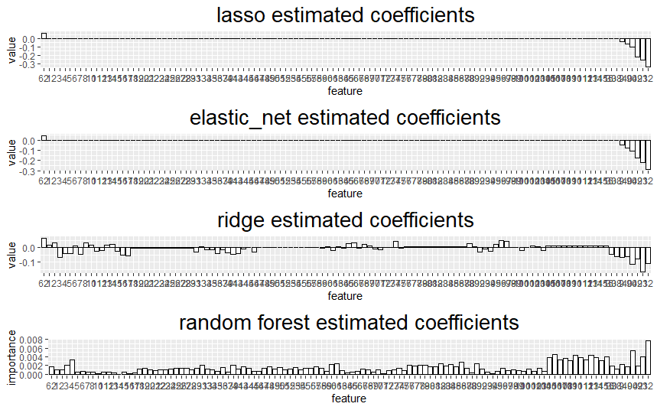
Bar plots of coefficients

Slide 7
Conclusion
Both logistic regressions and random forest has moderate accuracy on classifying the response. There is no trade-off of time and predictive performance here as the dataset contains only 1059 observations. Lasso and elastic-net agree on almost the same features.

